Slide 1

EasyRun
---An Information Sharing App for Grad School Applyer
DEMO
technical
REFLECTION
Penghao Weng
pw1298@nyu.edu
Tang Sheng
ts3906@nyu.edu
Yuqian Sun
ys3982@nyu.edu

Slide 2
DEMO TIME

Slide 3
Technical
Jay : Contract & Rating ---- Frontend
Kyrie: Contract ---- Backend
Sienna: Comment ---- Frontend
Sienna: Testing

Slide 4
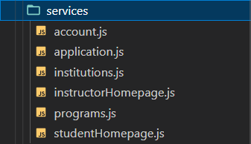
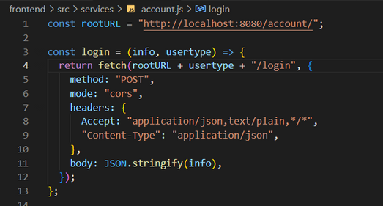
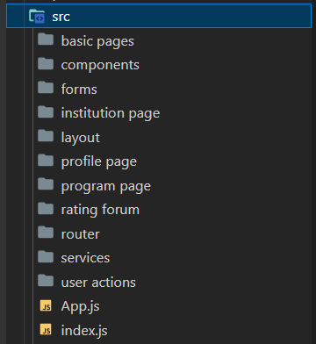
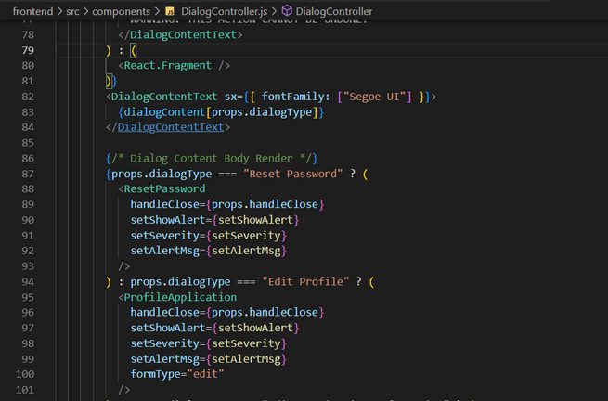
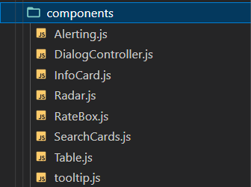
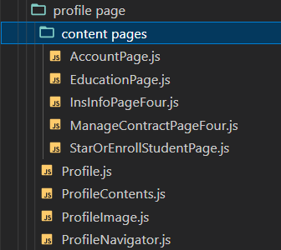
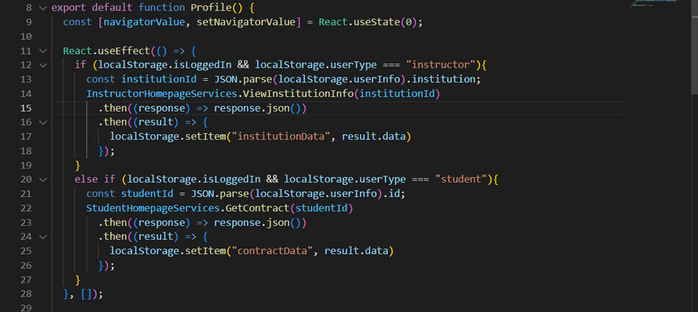
FRONT-END FILE STRUCTURE

Slide 5
CONTRACT
(FRONTEND)
COMPONENTS
CODE IMPLEMENTATION
DESIGN PATTERN

Slide 6
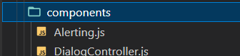
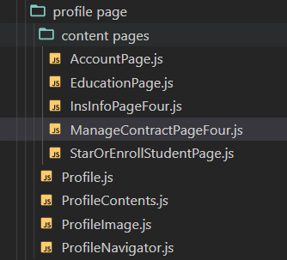
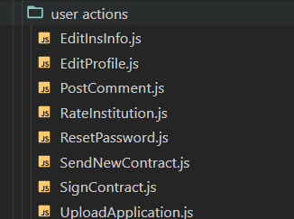
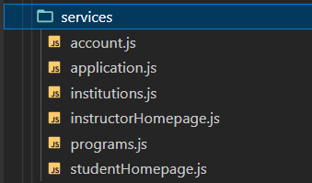
COMPONENTS

Slide 7
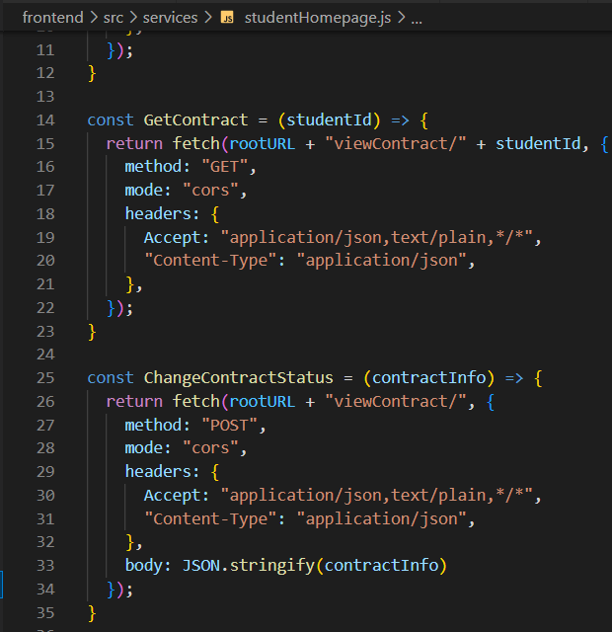
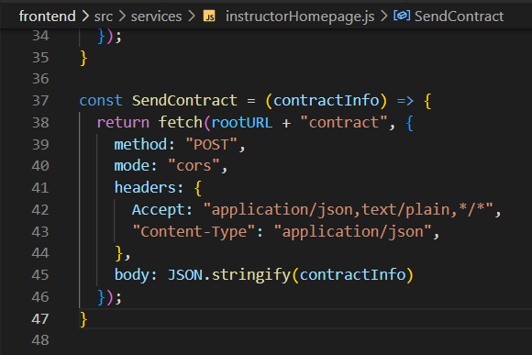
IMPLEMENTATION
(SERVICES)

Slide 8
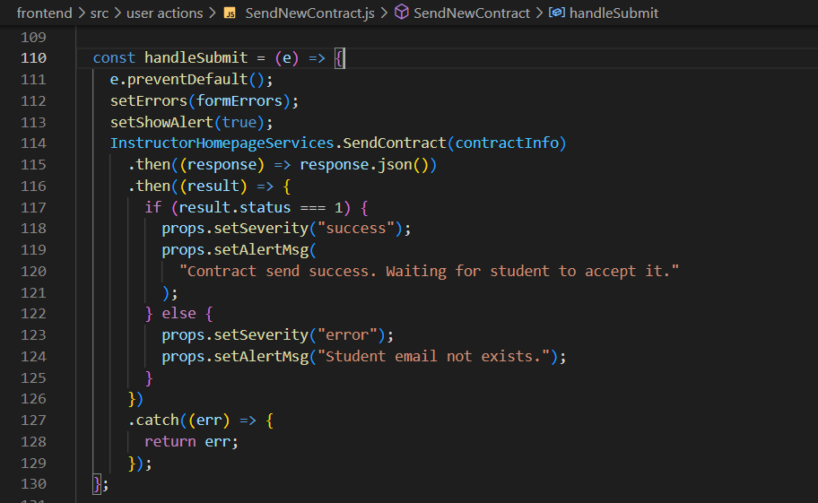
IMPLEMENTATION
(SEND CONTRACT)

Slide 9
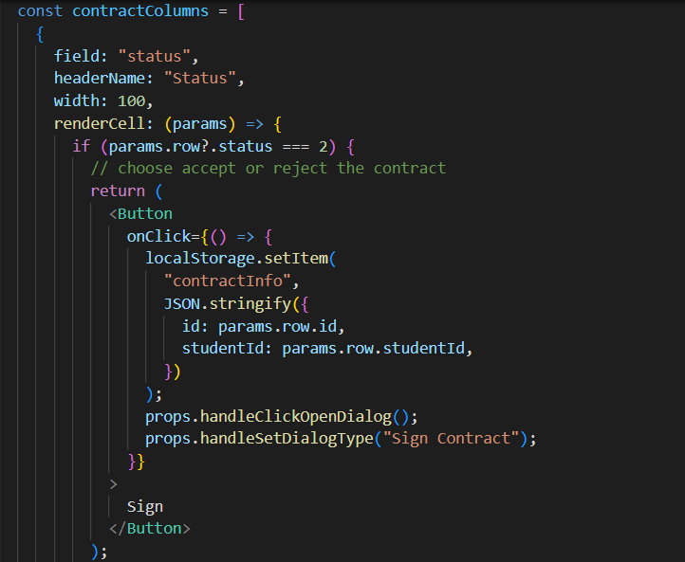
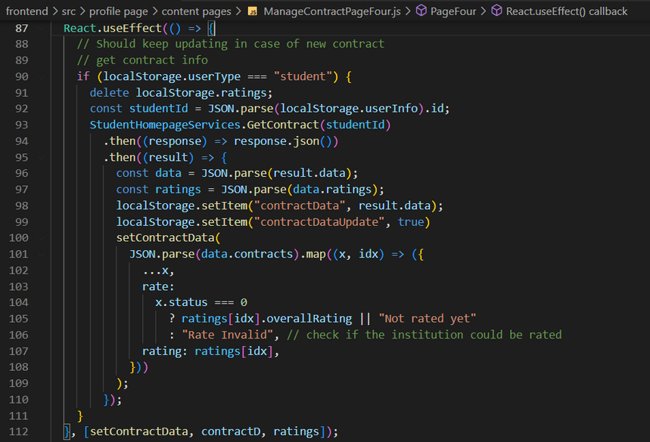
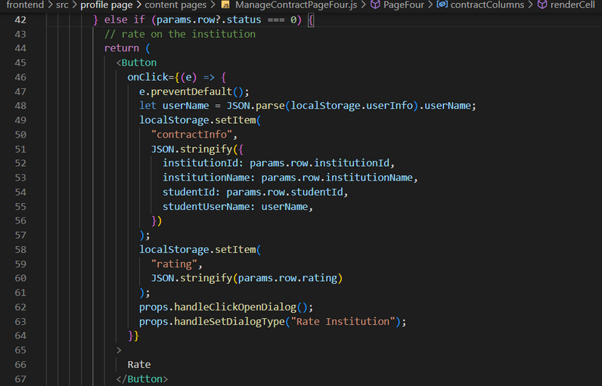
IMPLEMENTATION
(GET CONTRACT INFO)

Slide 10
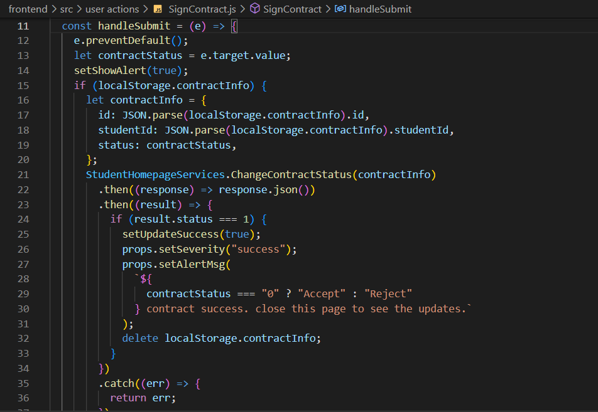
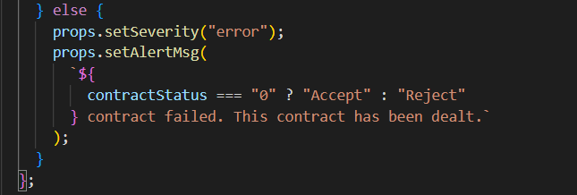
IMPLEMENTATION
(CHANGE CONTRACT STATUS)

Slide 11
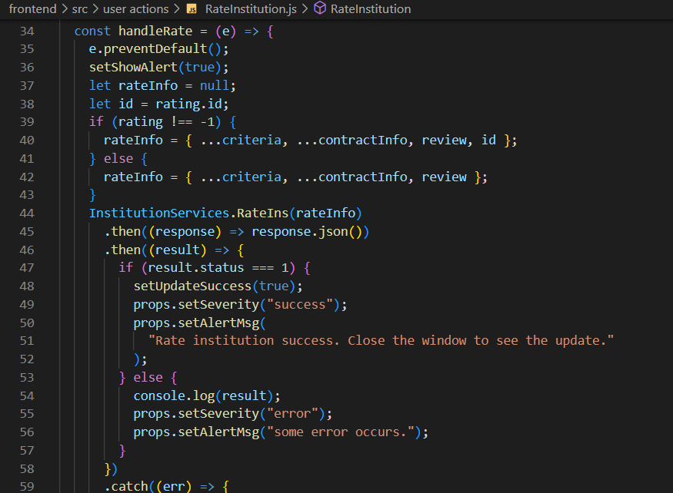
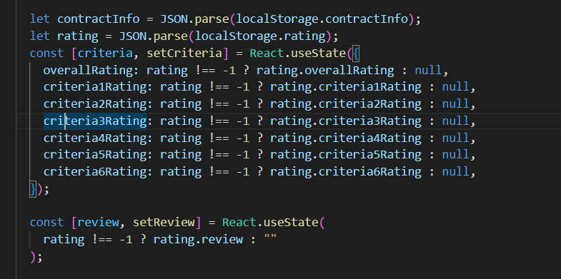
IMPLEMENTATION
(RATE INSTITUTION)

Slide 12
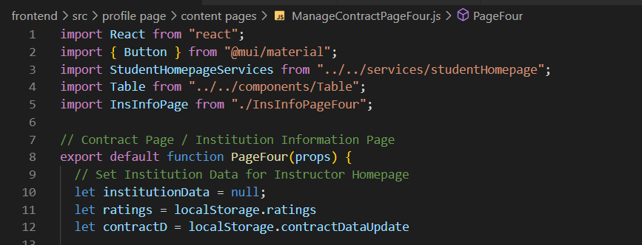
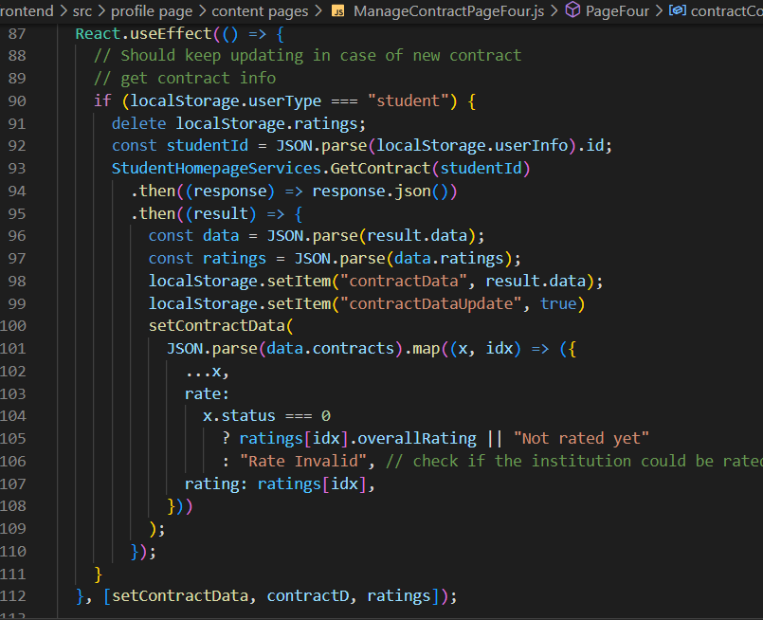
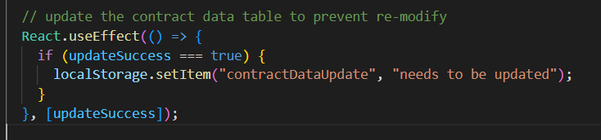
OBSERVER PATTERN

Slide 13
Sending CONTRACT
to Student
(BACKEND)
FILE STRUCTURE
CODE IMPLEMENTATION
EXTRA DESIGN PATTERN

Slide 14
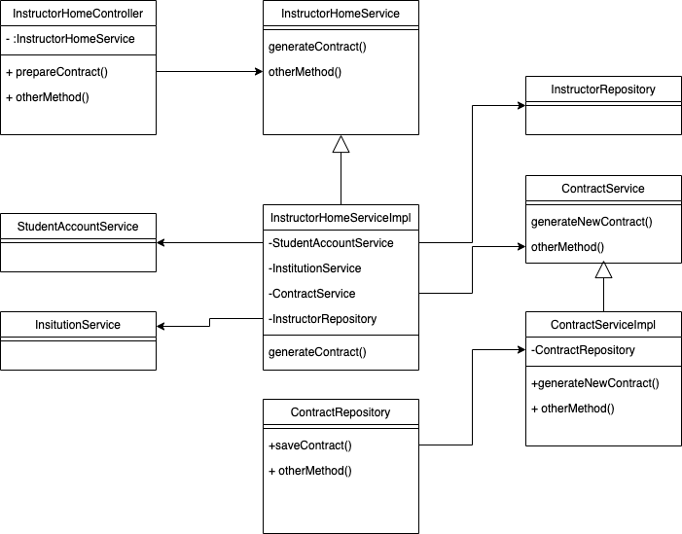
File Structure
Use micro services. Each entity type has its own service that completes simple functions.
Only the Service of one entity type can access its own repository.
Centralized. The instructor service is the center that calls all other micro services.
01
02
04

Slide 15
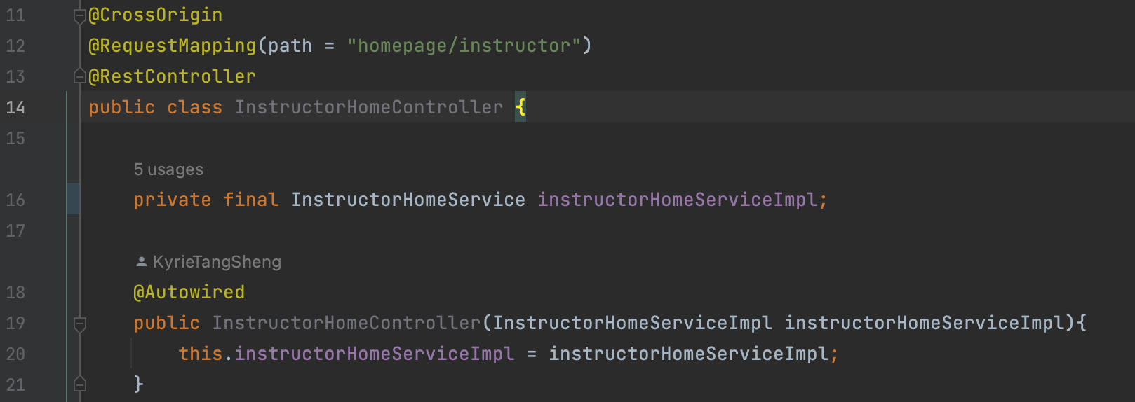
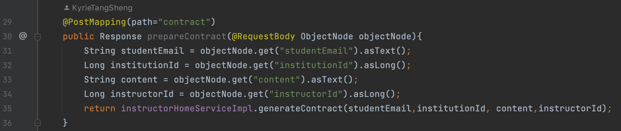
Controller
04

Slide 16
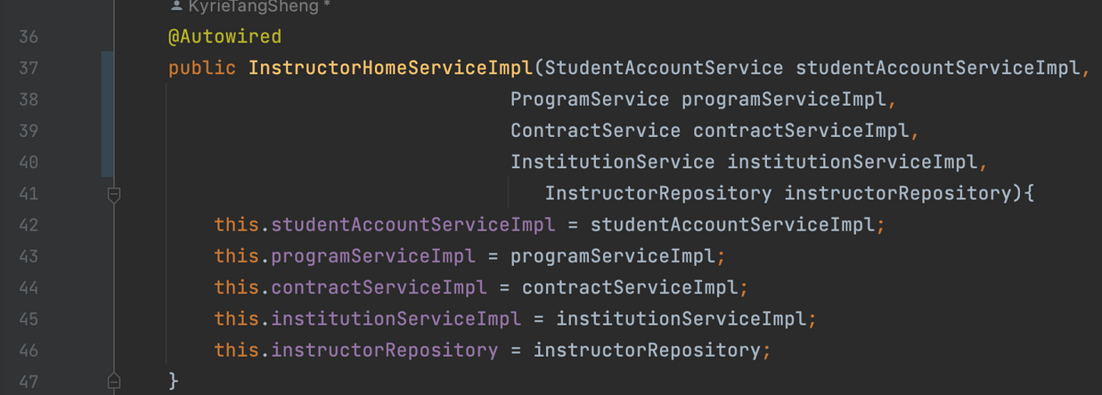
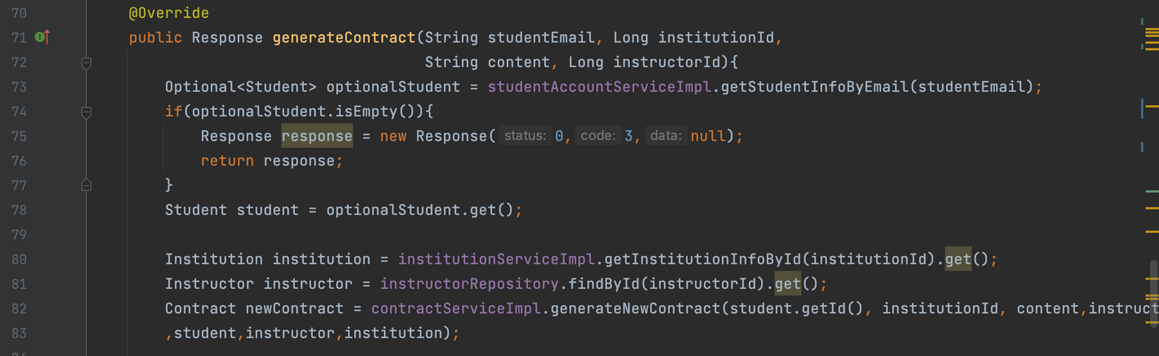
InstructorService
04

Slide 17
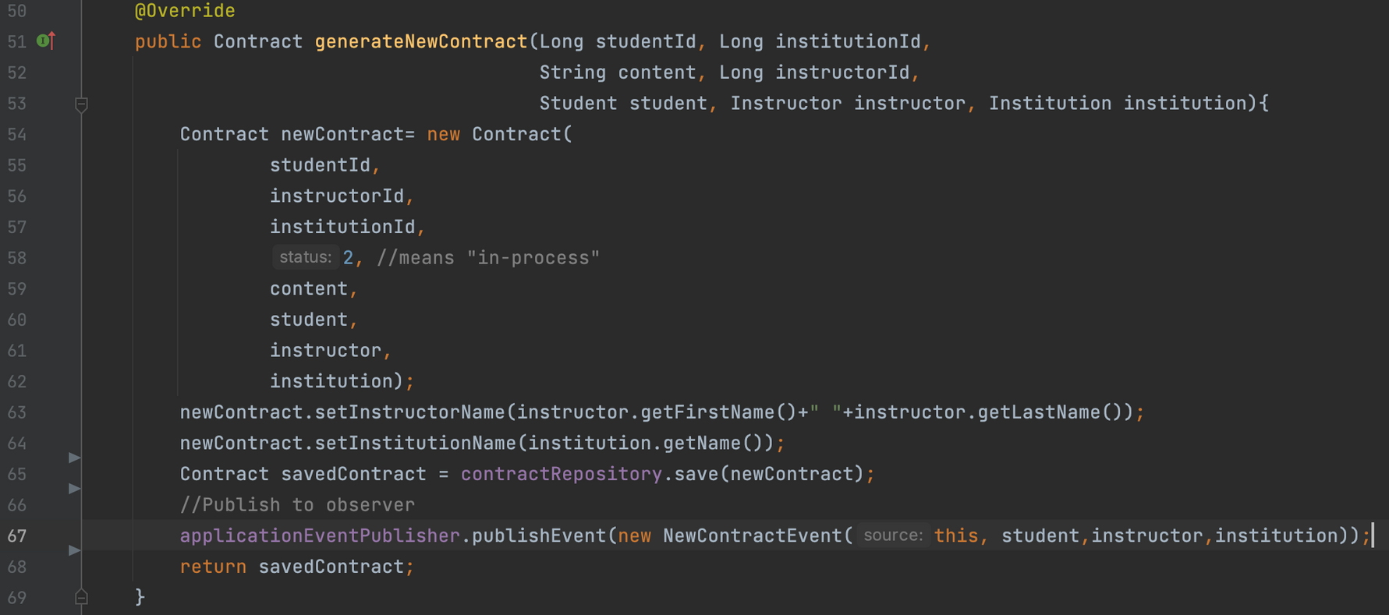
ContractService
04

Slide 18
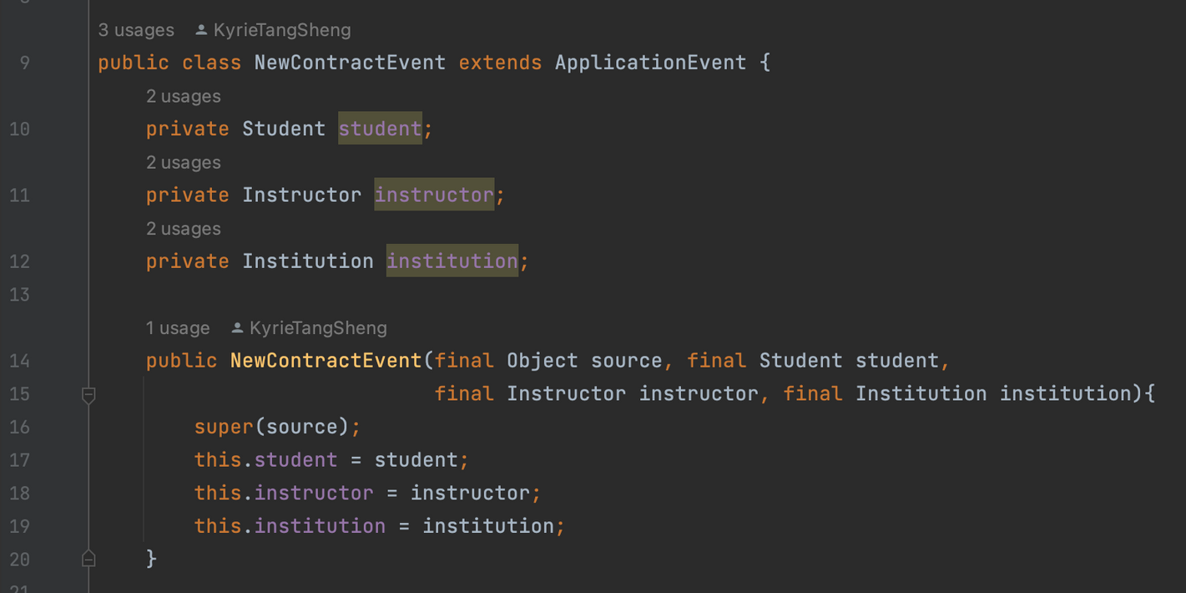
Observer Pattern
The "Notifier"
The "Observer"
04

Slide 19
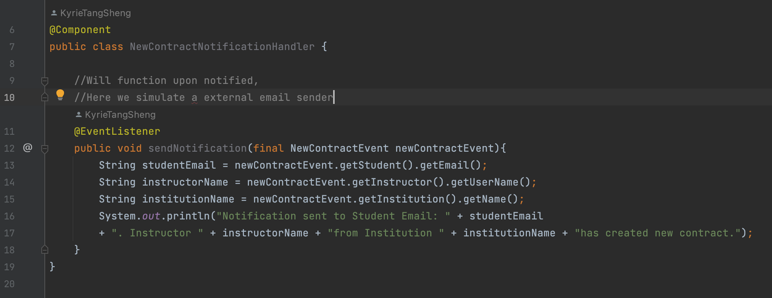
Observer Pattern
The "observer.update()" method
04
----Why do we need a new handler, instead of just a "update()" function?
----Because we can separate the behavior apart this way, and evolvement would be easier.

Slide 20
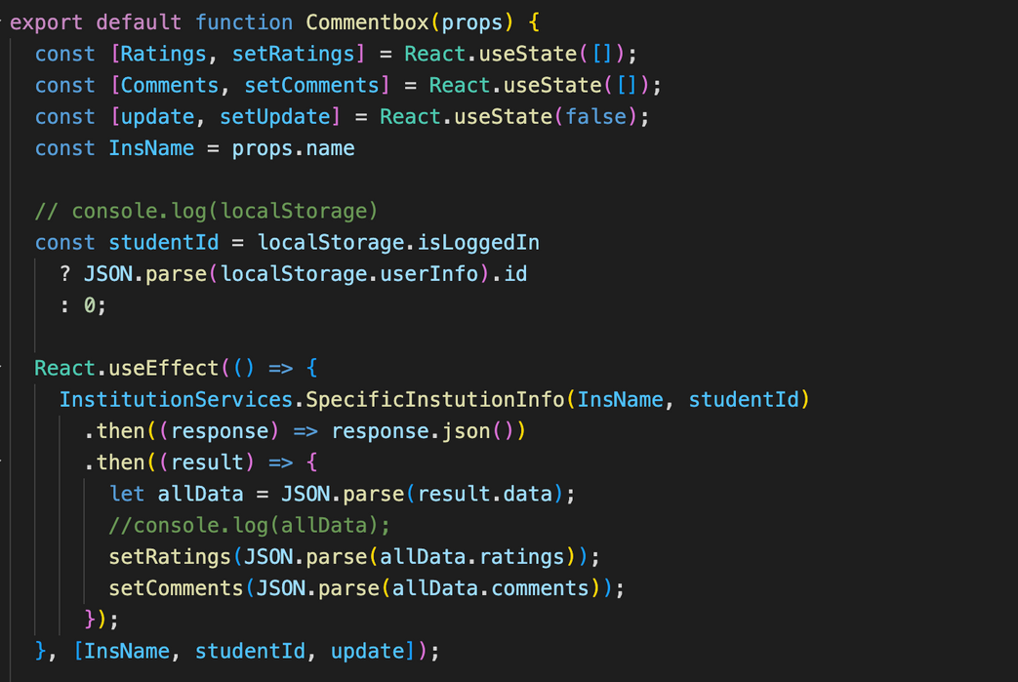
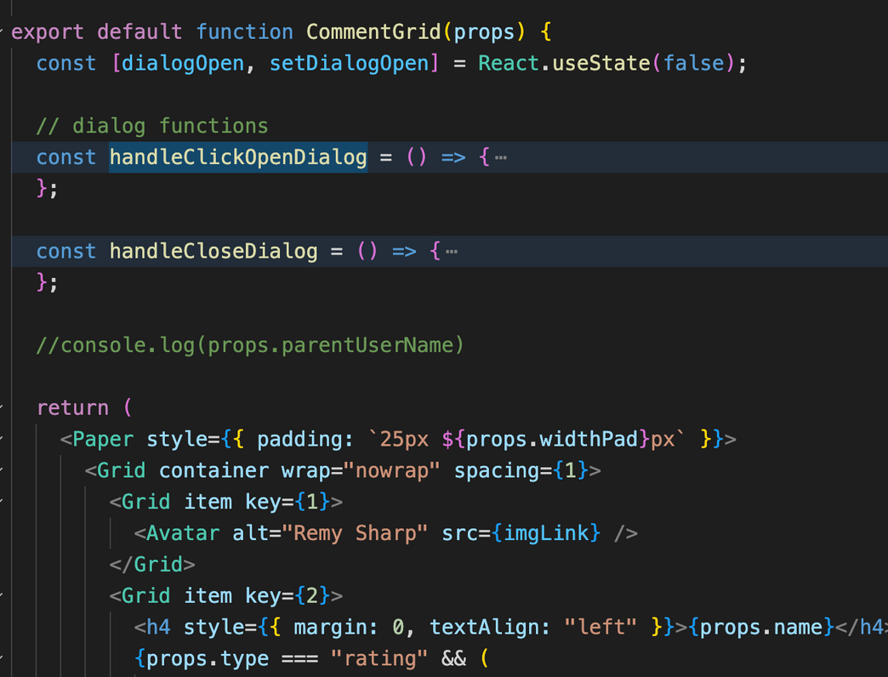
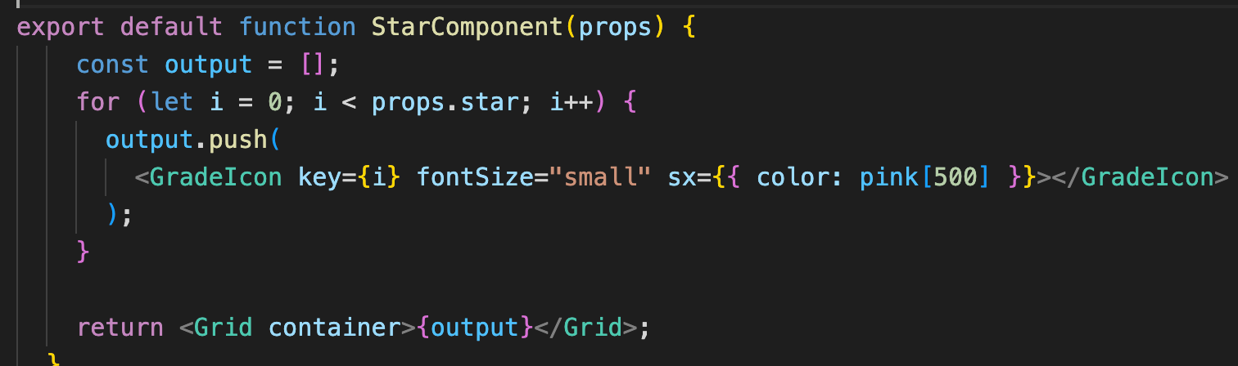
Comment
Functions
DISPLAY COMMENTS AND STARS
COMMENT RATORS AND COMMENTERS
UPDATE SYNCHRONOUS

Slide 21
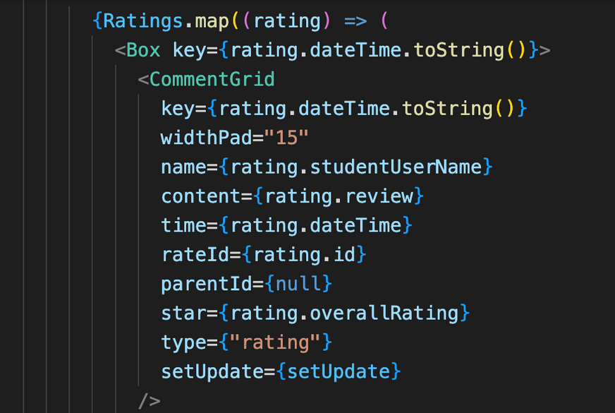
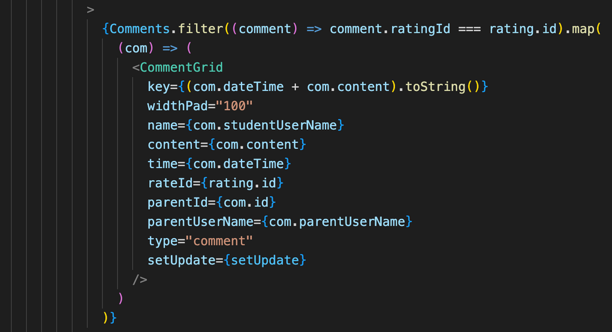
Comment
Data needed?
Rater? Commenter?
NESTED STRUCTURE
DISTINGUISH TWO TYPES OF ROLES
PASS IN NECESSARY PARAMETERS THROUGH PROPS AND LOCAL STORAGE

Slide 22
Comment
COMMENT BOX
Data needed?
Rater? Commenter?
BUTTON
NESTED STRUCTURE
DISTINGUISH TWO TYPES OF ROLES THROUGH BUTTONS
PASS IN NECESSARY PARAMETERS THROUGH PROPS
DIALOGUE
UPDATE

Slide 23
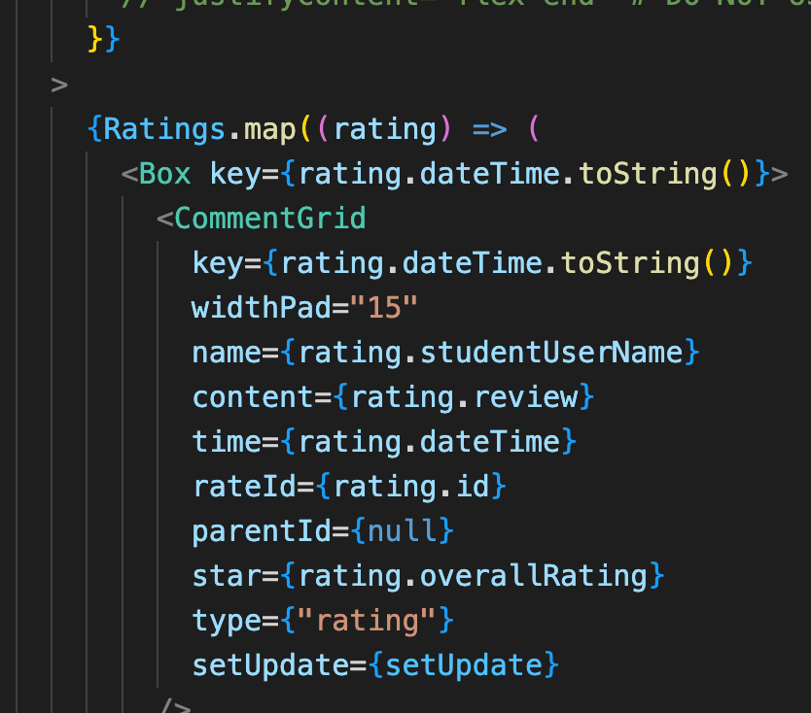
Comment
COMPONENT
CLASSES

Slide 24
Comment
SOME COMPONENT
"ABSTRACT CLASSES"

Slide 25
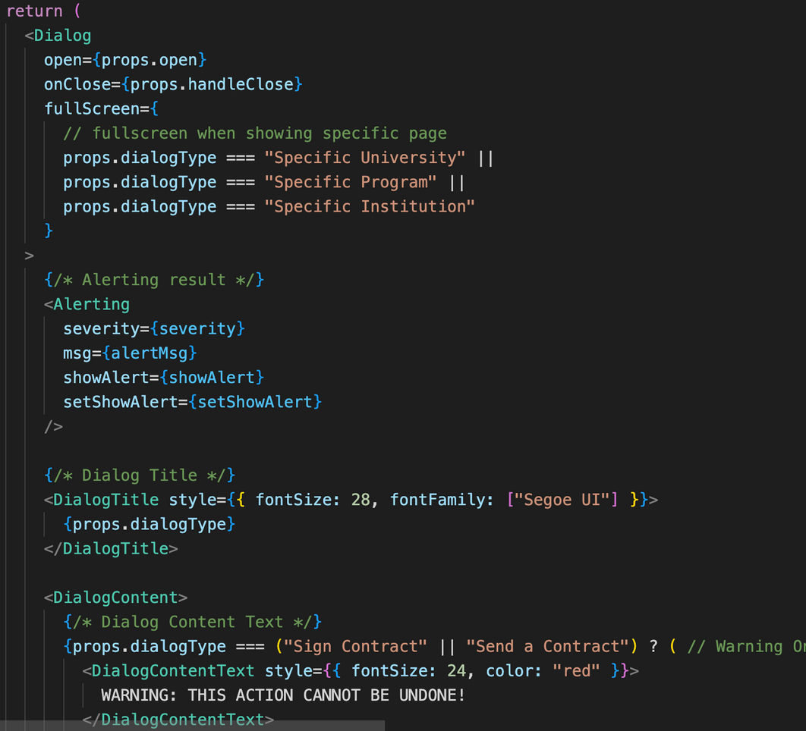

Slide 26
REACT
OOP
encapsulation
building blocks for reuse
FP
function as object
UI = f(state)
State Pattern

Slide 27
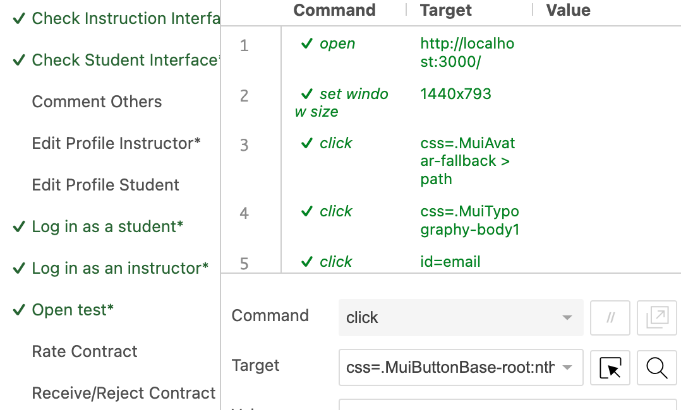
Selenium Test

Slide 28
Reflection

Slide 29
Things we can do better
1
API DOCUMENTATION
2
AVATAR SYSTEM
3
CHAT SYSTEM
4
WEB CRAWLER
5
DISTRIBUTED SYSTEM

Slide 30
Teamwork
KYRIE
BACKEND
JAY
FRONTEND
SIENNA
COWORKED FRONTEND AND TEST

Slide 31

Thank you for listening!

